Slide 1
Impact of aviation on Cirrus Cloud Formation within European airspace - Update IV
Timothy van der Duim
Student Climate Physics

Slide 2
Cirrus data project
Progress made
Managed to download all CALIPSO data!
Analyzed spatial and diurnal coverage of CALIPSO LIDAR L2 product
Did large part of time series analysis
Looked into ML techniques to filter out cells where cirrus cannot form
Processed air traffic data from 2019 and 2020 (from different source)

Slide 3
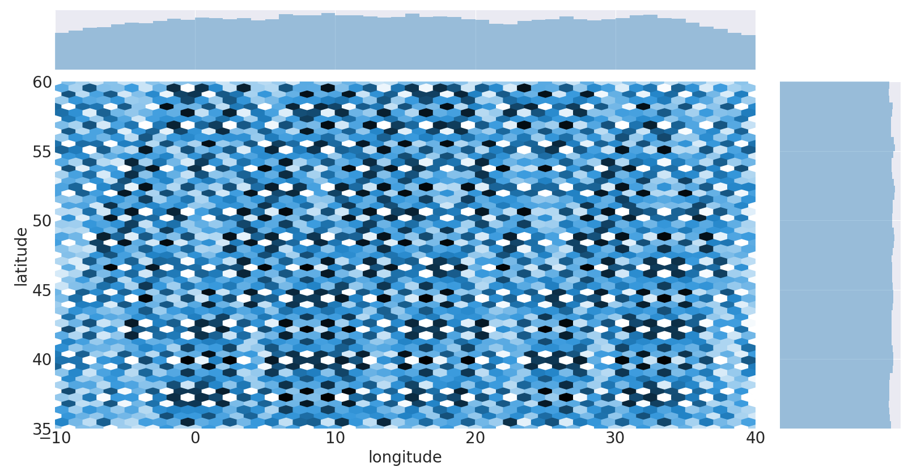
Cirrus data project
Spatial coverage CALIPSO – Mar 2015

Slide 4
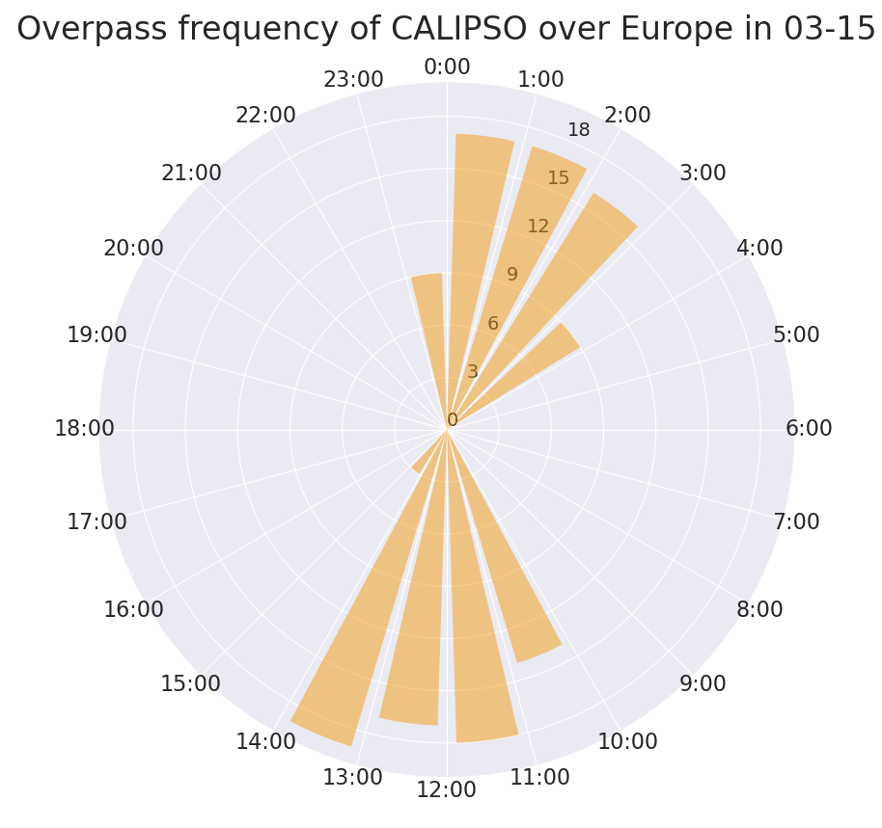
Cirrus data project
Temporal coverage
CALIPSO – Mar 2015
Overpasses mostly after midnight and around noon
Times shown is UTC time

Slide 5
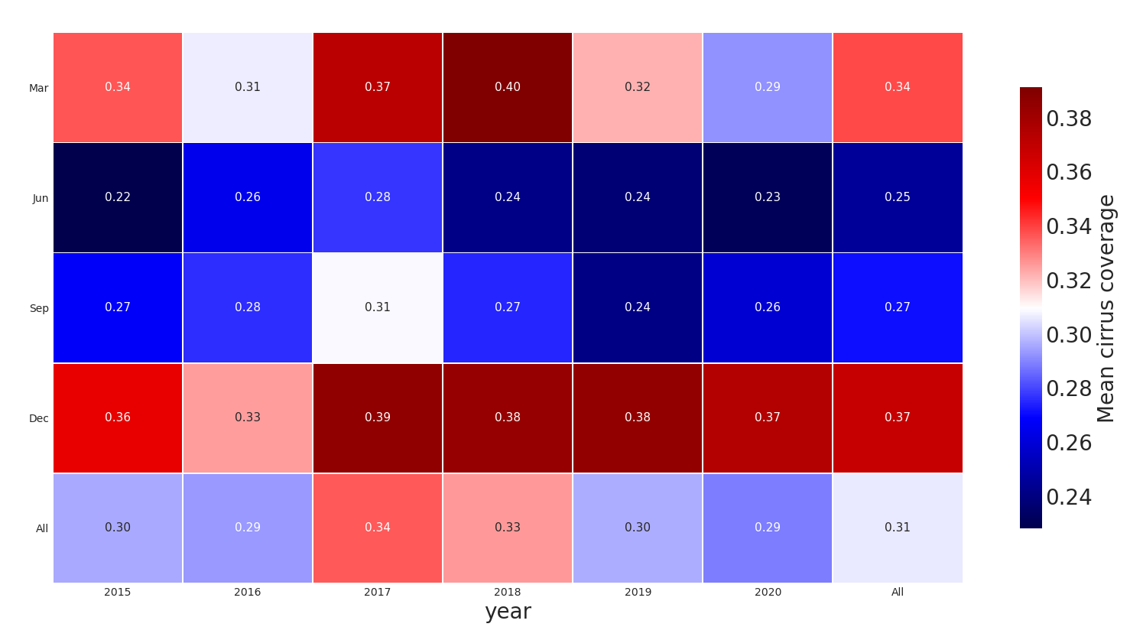
Cirrus data project
Heat map cirrus cover
CALIPSO LIDAR data analyzed for 4 months, during 6 years over Europe ([35, 60]N, [-10, 40]E)
Includes medium & high confidence cloud types, subtype “cirrus” between 100 and 400 hPa (roughly between 6 and 16 km alt)

Slide 6
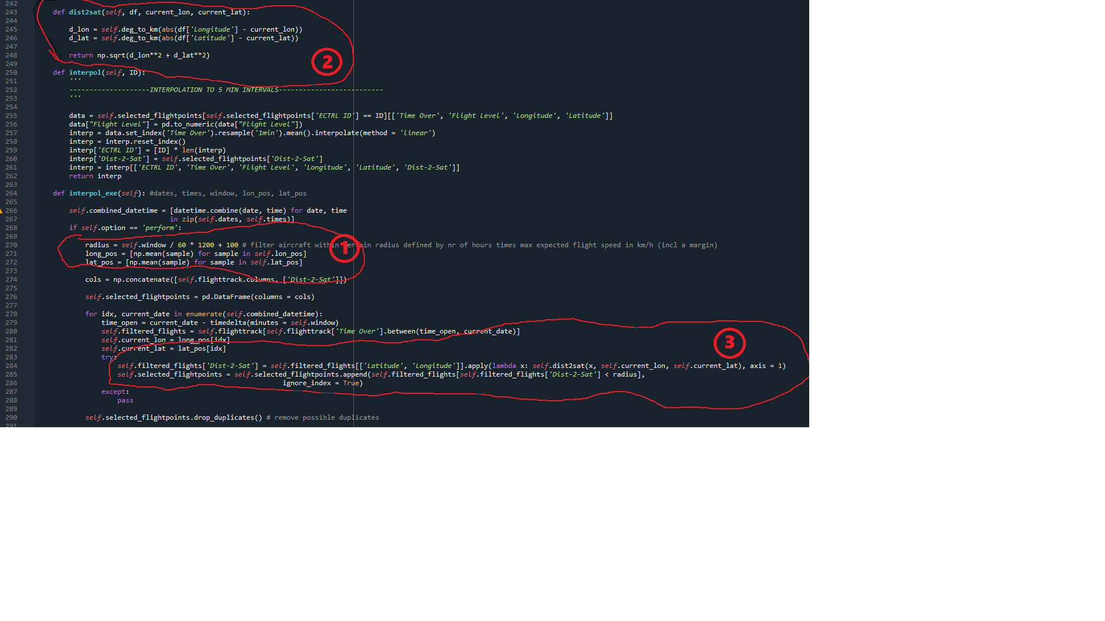
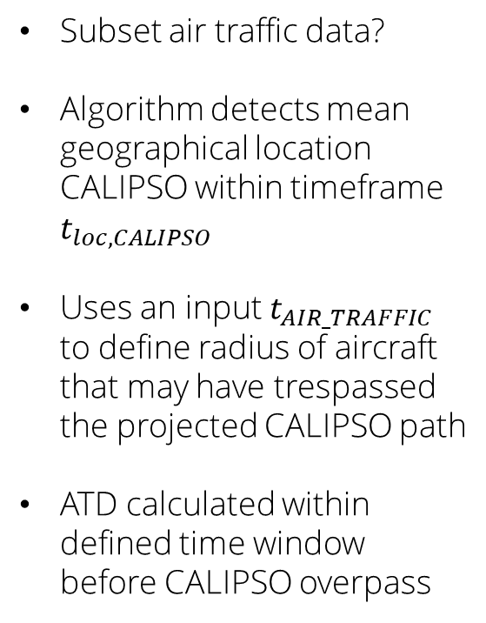
Cirrus data project
Air traffic data
Subset air traffic data?
Algorithm detects mean geographical location CALIPSO within timeframe $t_{loc,CALIPSO}$
Uses an input $t_{AIR_TRAFFIC}$ to define radius of aircraft that may have trespassed the projected CALIPSO path
ATD calculated within defined time window before CALIPSO overpass

Slide 7
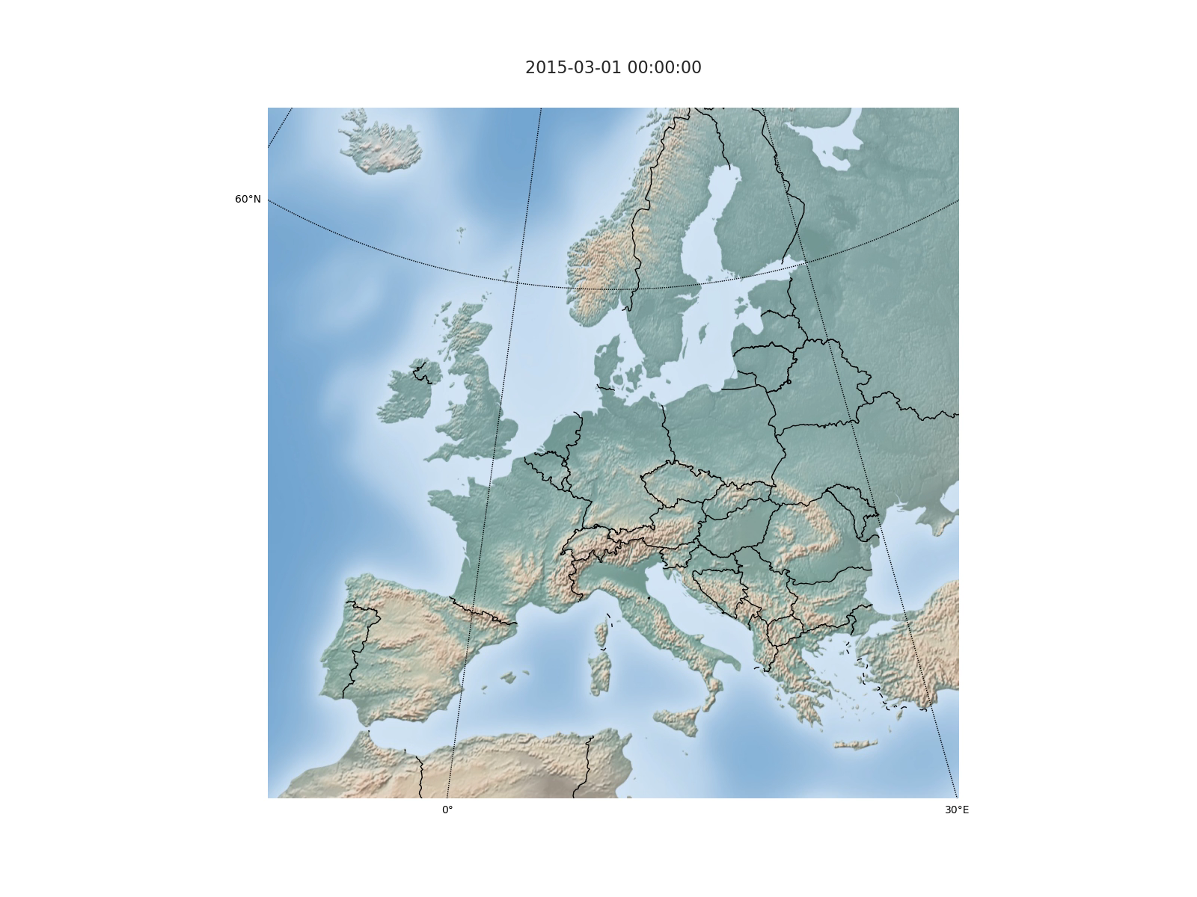
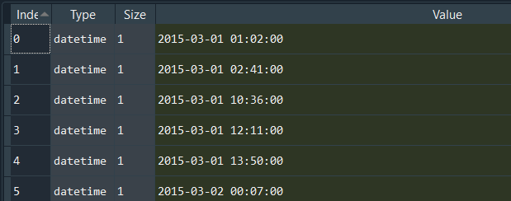
Cirrus data project
Air traffic data

Slide 8
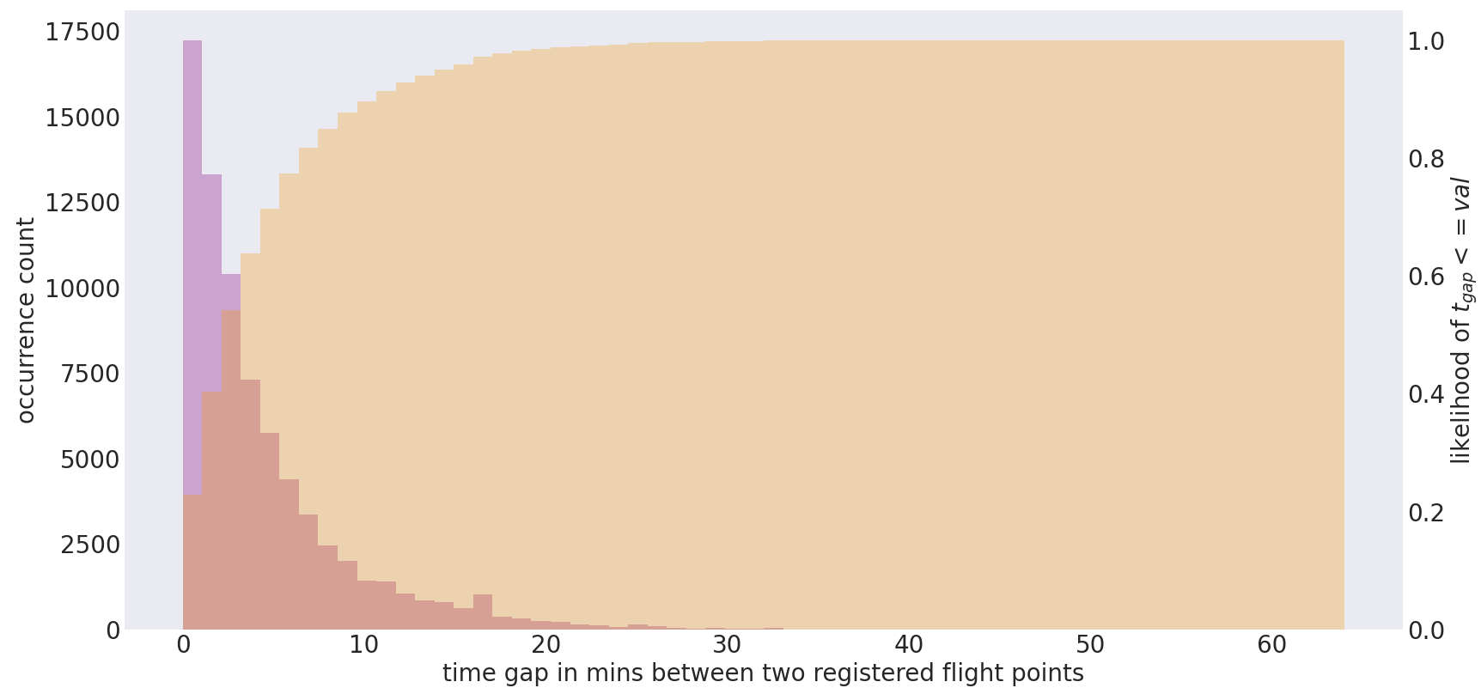
Cirrus data project
Time intervals flight data
Subset air traffic data?
Flightpoints interpolation interval taken as 1 min

Slide 9

Cirrus data project
Flight dataset from Zenodo – Mar 2019

Slide 10
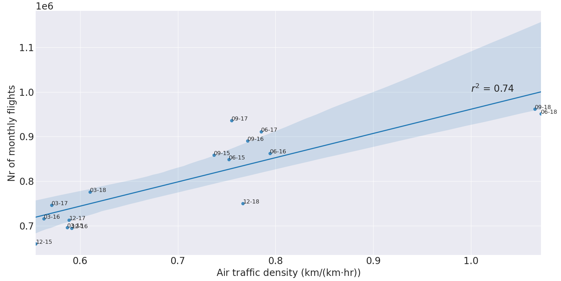
Cirrus data project
Handling low quality data 19-20
ATD vs total number of flights for months in 2015-2018
Use linear regression model to predict ATD for 2019-2020

Slide 11
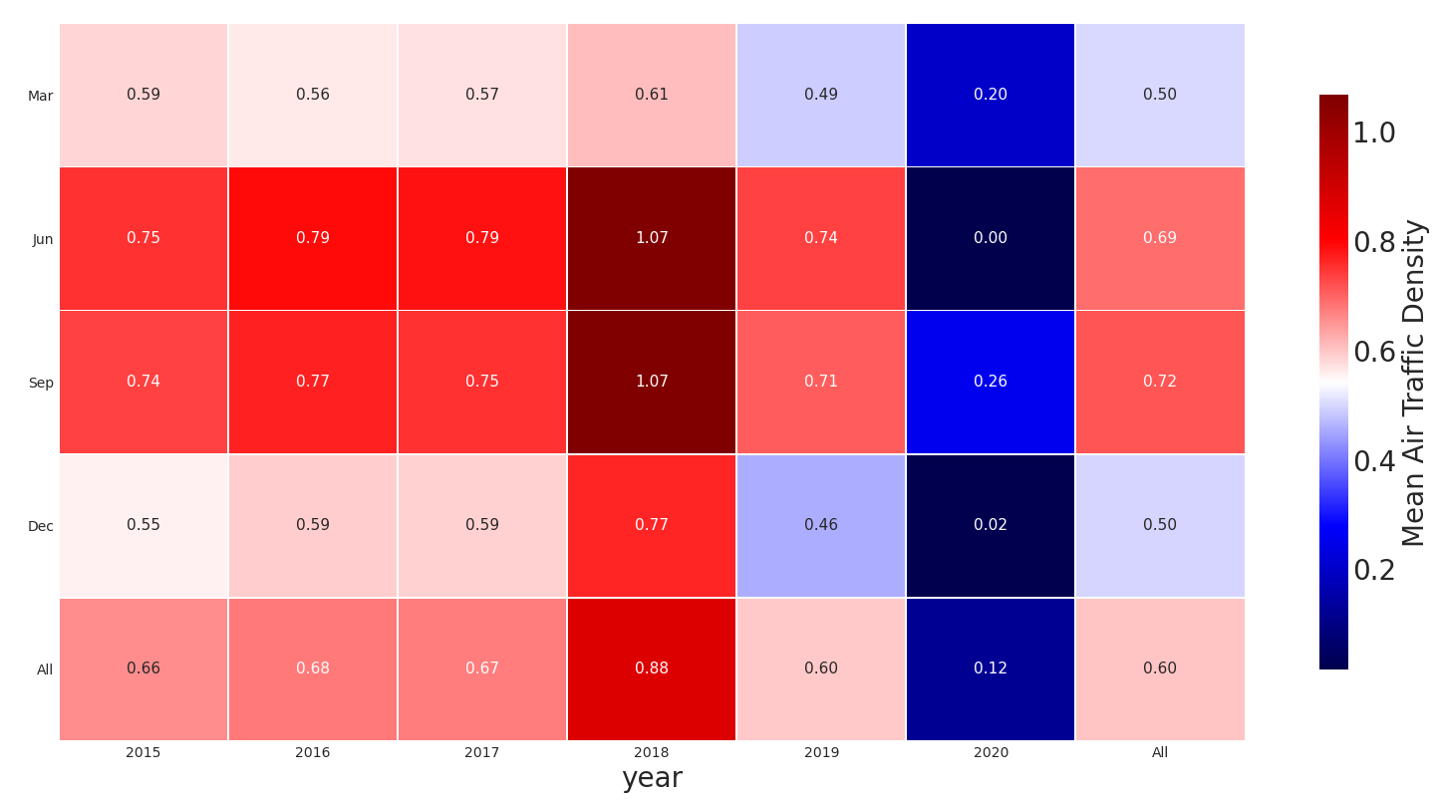
Cirrus data project
Heat map Air Traffic Density
After application of linear regression model
2019 & 2020 were predicted from linreg model

Slide 12
Cirrus data project
Heat map ATD vs cirrus cover

Slide 13
Cirrus data project
Meteorological conditions
Mean upper tropospheric T & rel. hum. too inaccurate -> divide upper tropo/lower strato in 7 layers
Use T, rel. hum (ERA5) and regridded cirrus cover (CALIPSO) in each layer as input for model
Train model to recognize where cirrus might occur (cirrus cover encoded into binary response)
Two methods considered:
Logistic regression
Random Forest (decision trees)

Slide 14
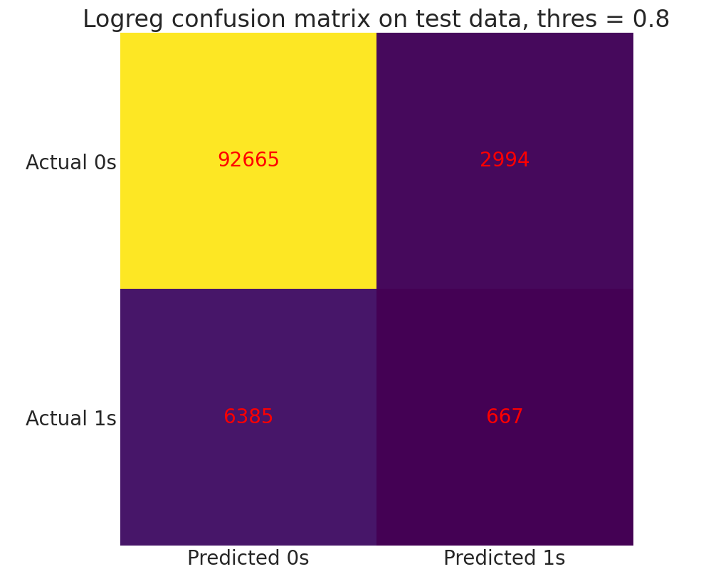
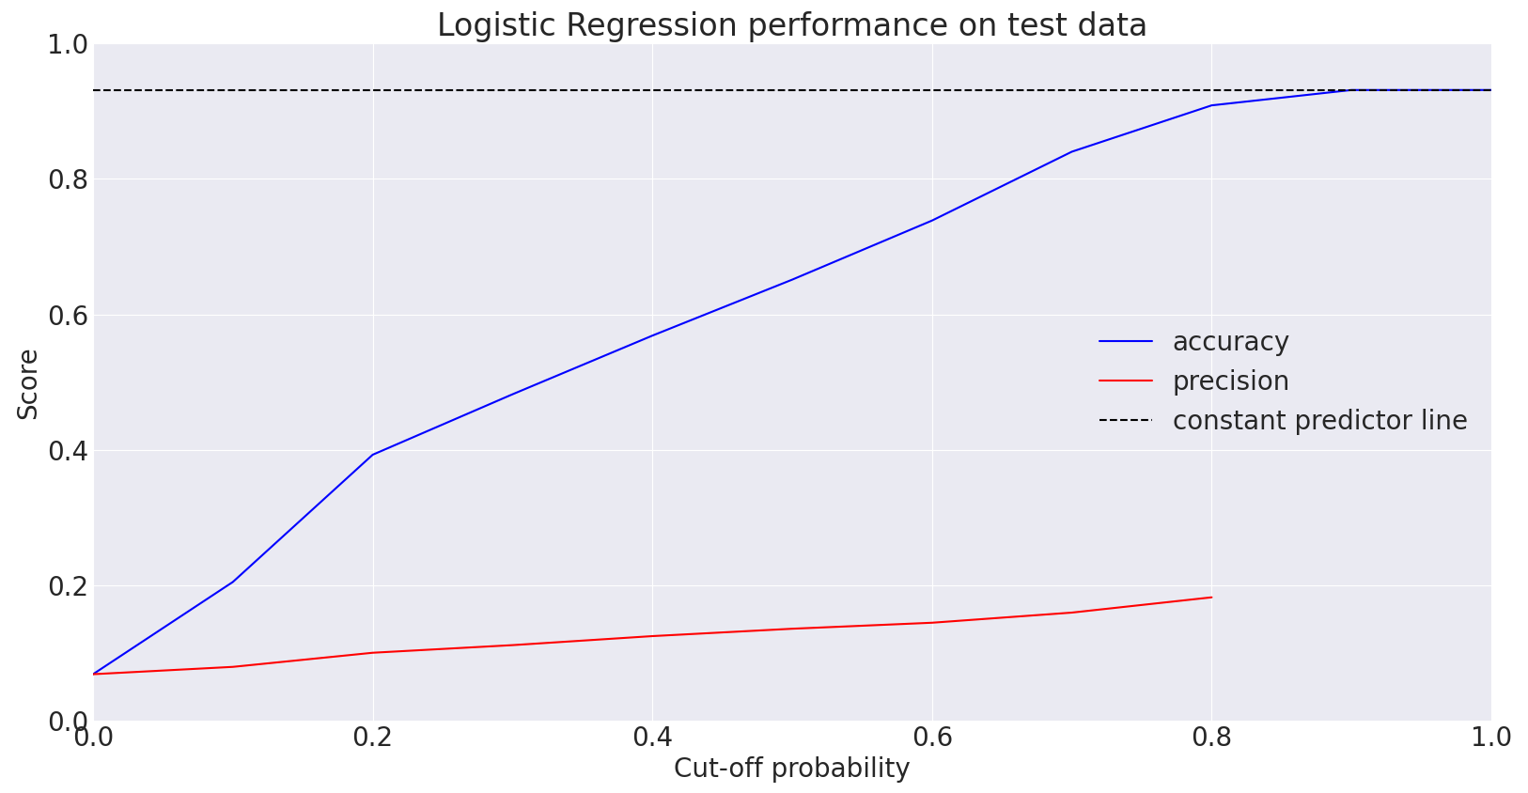
Cirrus data project
Logistic Regression

Slide 15
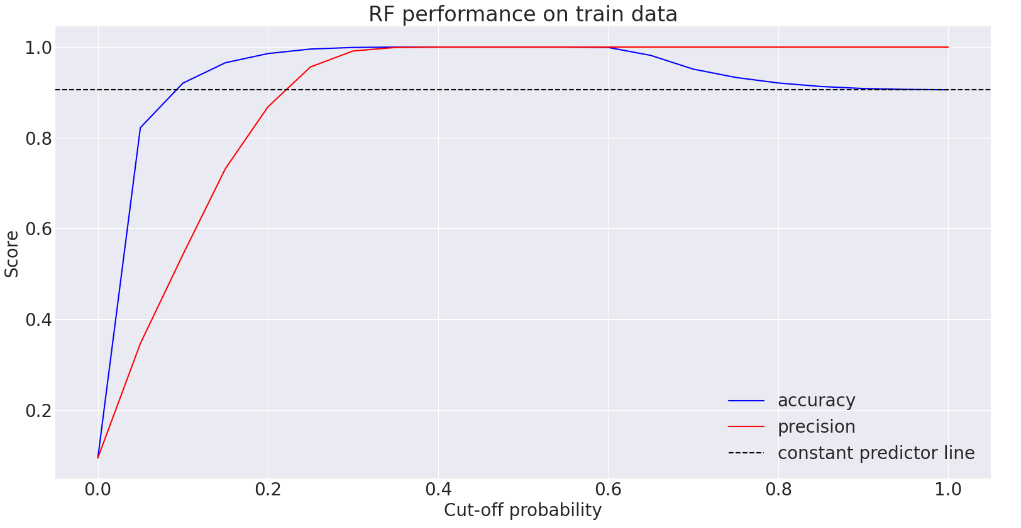
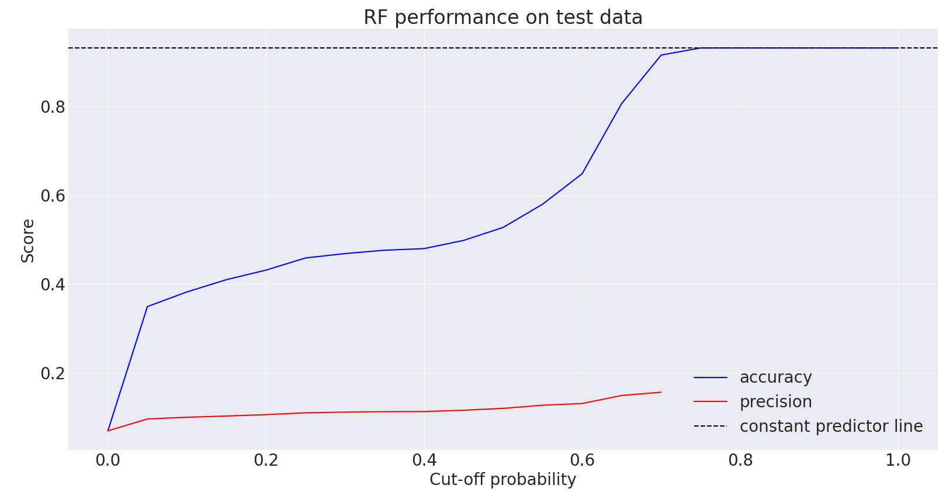
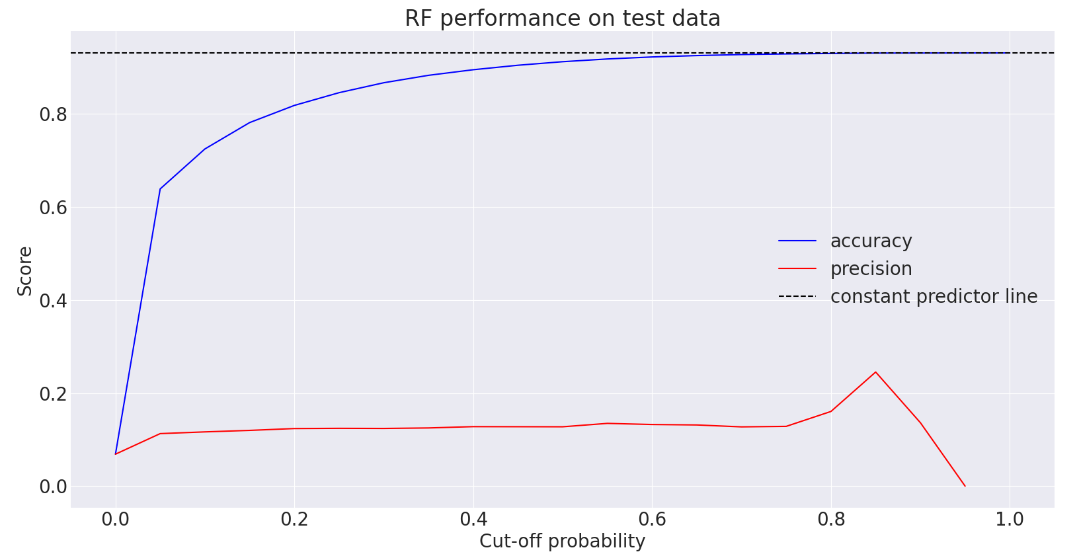
Random Forest
Max depth = 0
Max depth = 50

Slide 16
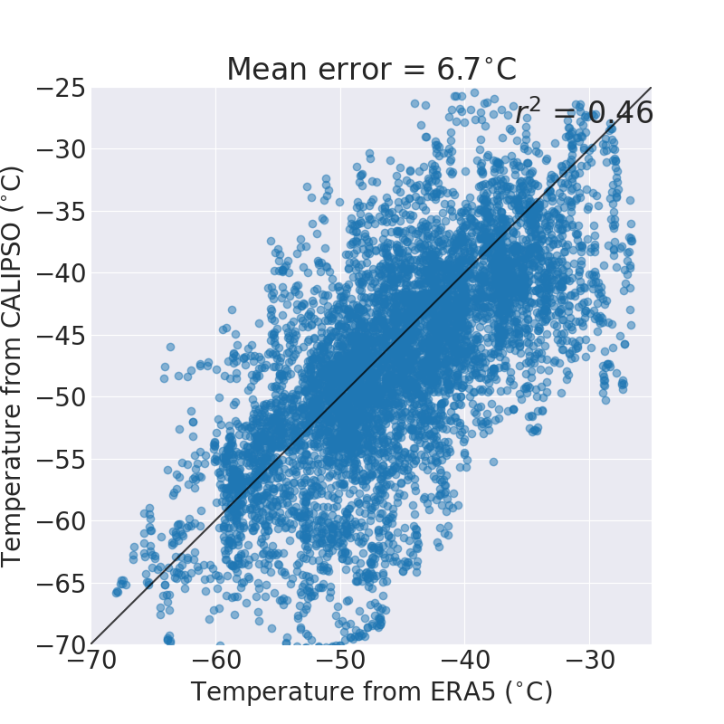
Cirrus data project
Temperature correlation
Correlation between cloud temperature from CALIPSO and air temperature from reanalysis
Upper troposphere divided into 7 layers (so e.g. 100hPa temperature is compared with cloud temperature from clouds between 75hPa & 125hPa)

Slide 17
Cirrus data project
Planning coming two weeks
Improve time series analysis, including error estimates and complete interpolation (Fortran)
Improve on ML model related to ERA5 data
Look into METEOSAT data (validate with CALIPSO)
Correlate high temporal resolution data with air traffic data (bin cells based on (W)ATD)

